Slide 1
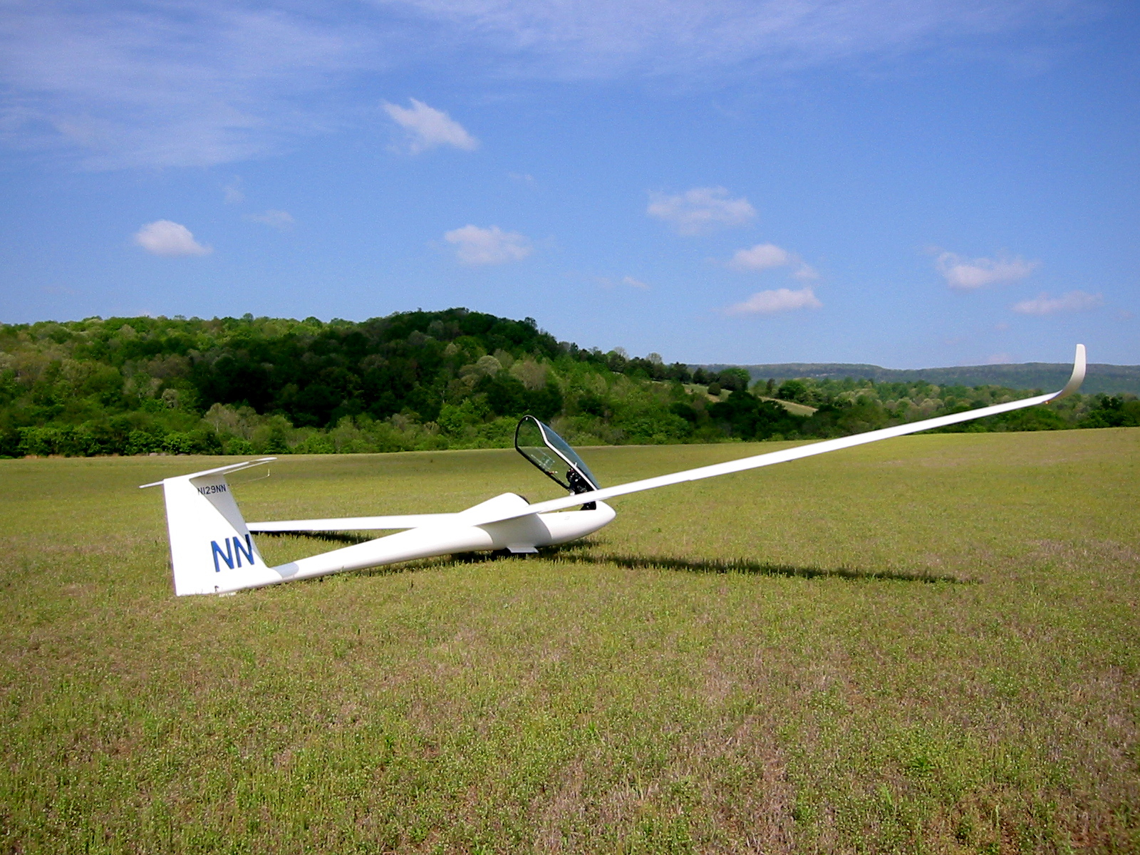
Cross-Country for Beginners Part 5: Landing Out
Bill Elliott and Rand Baldwin

Slide 2
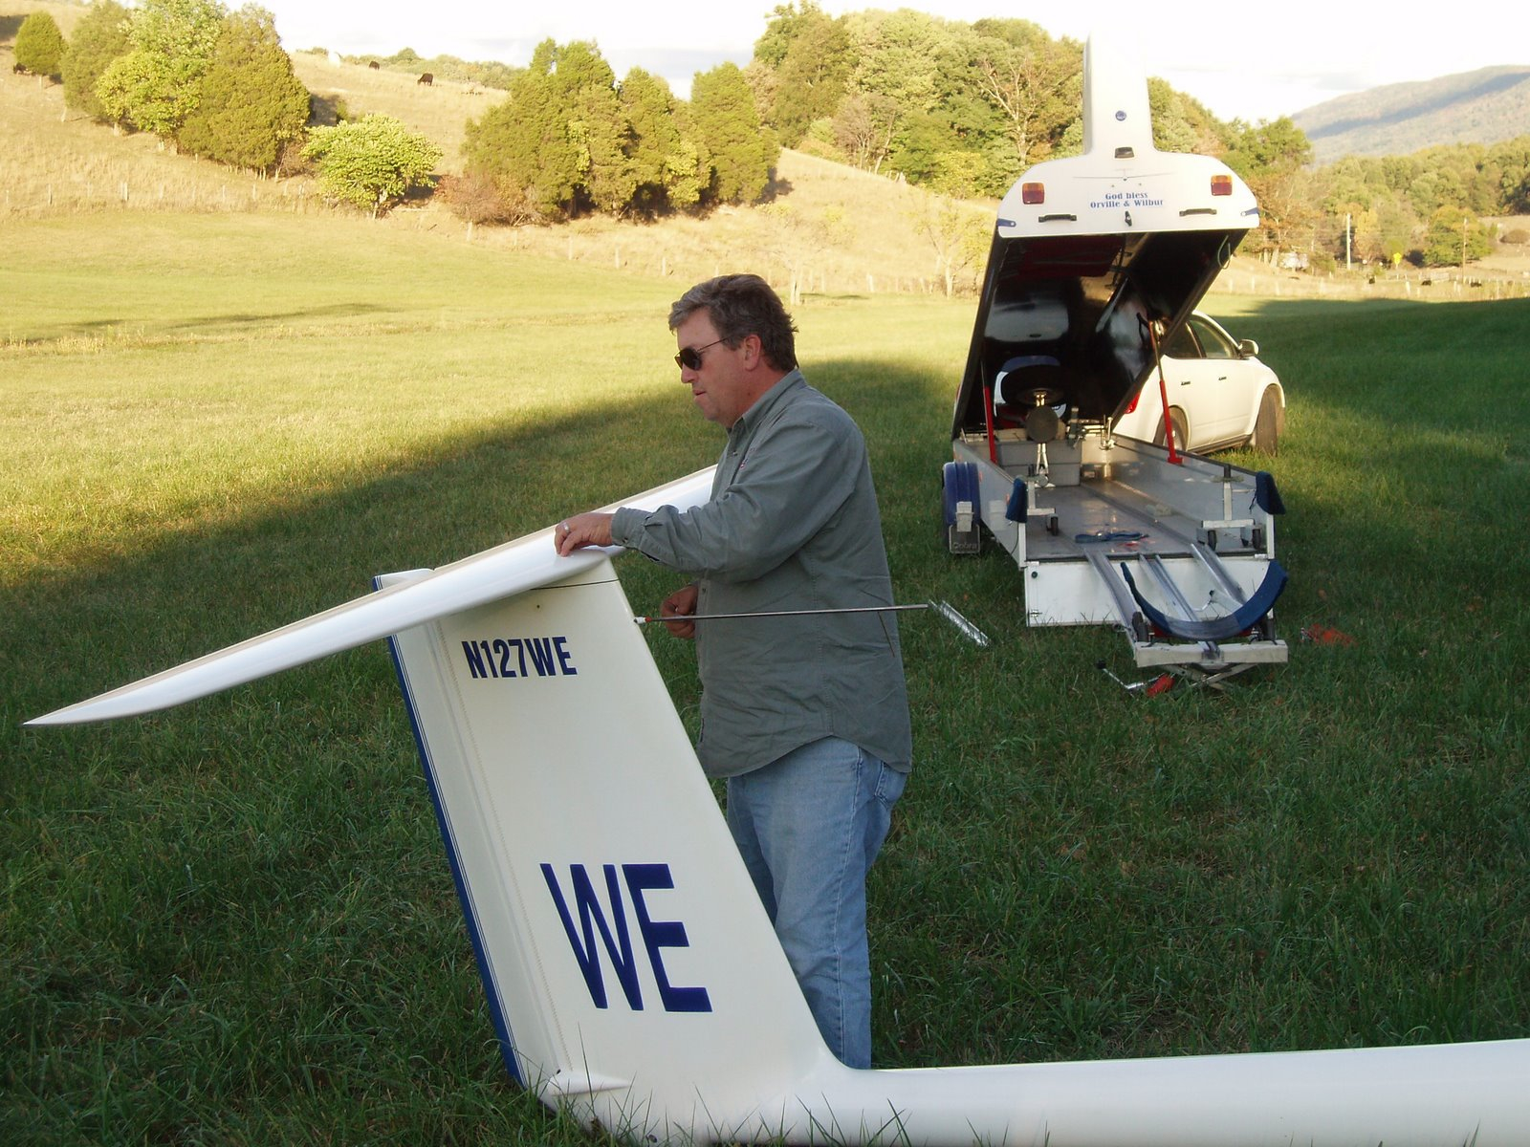
Six Week Agenda
Weather and Preparation (needed skills, glider & instrumentation, biological)
Thermals and Triggers
Climbing—and the art of thermaling
Cruising and In-Flight Decision Making
Landing Out and Post-Flight Analysis
Flight Computers and Final Glides

Slide 3
Personal Equipment
Cell phone
SPOT
Water and food
Survival kit
Extra clothing
Road maps – in case you can’t access Google Maps
Pen and paper
Giveaways – brochures, DVDs, business cards
Book, iPod, etc. to entertain yourself while you await your ever-faithful crew

Slide 4
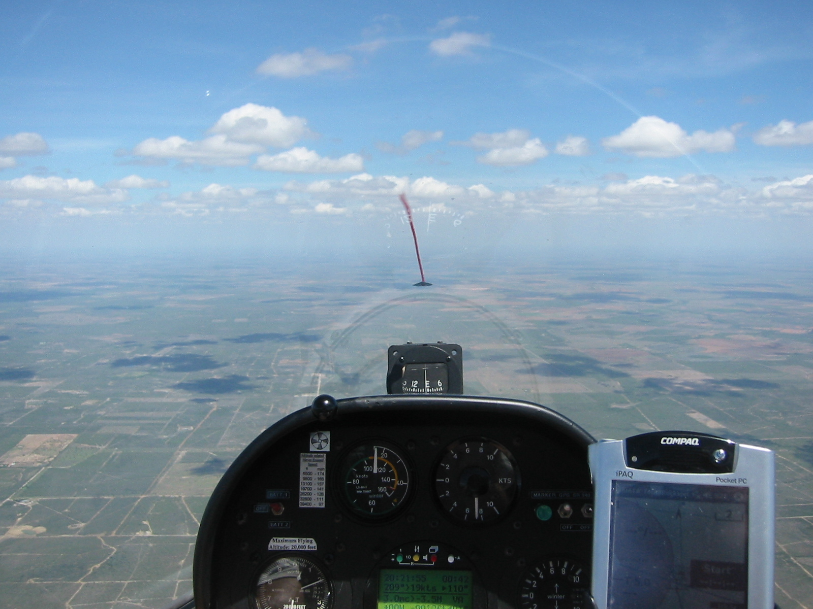
Thinking Ahead
“Remember, you fly a glider
with your head, not with your hands.”
- Kai Gertsen, Introduction to Cross Country Soaring -

Slide 5
Thinking Ahead
“Never let the glider take you somewhere your brain didn’t get to five minutes earlier.”
- Kai Gertsen, Introduction to Cross Country Soaring -

Slide 6
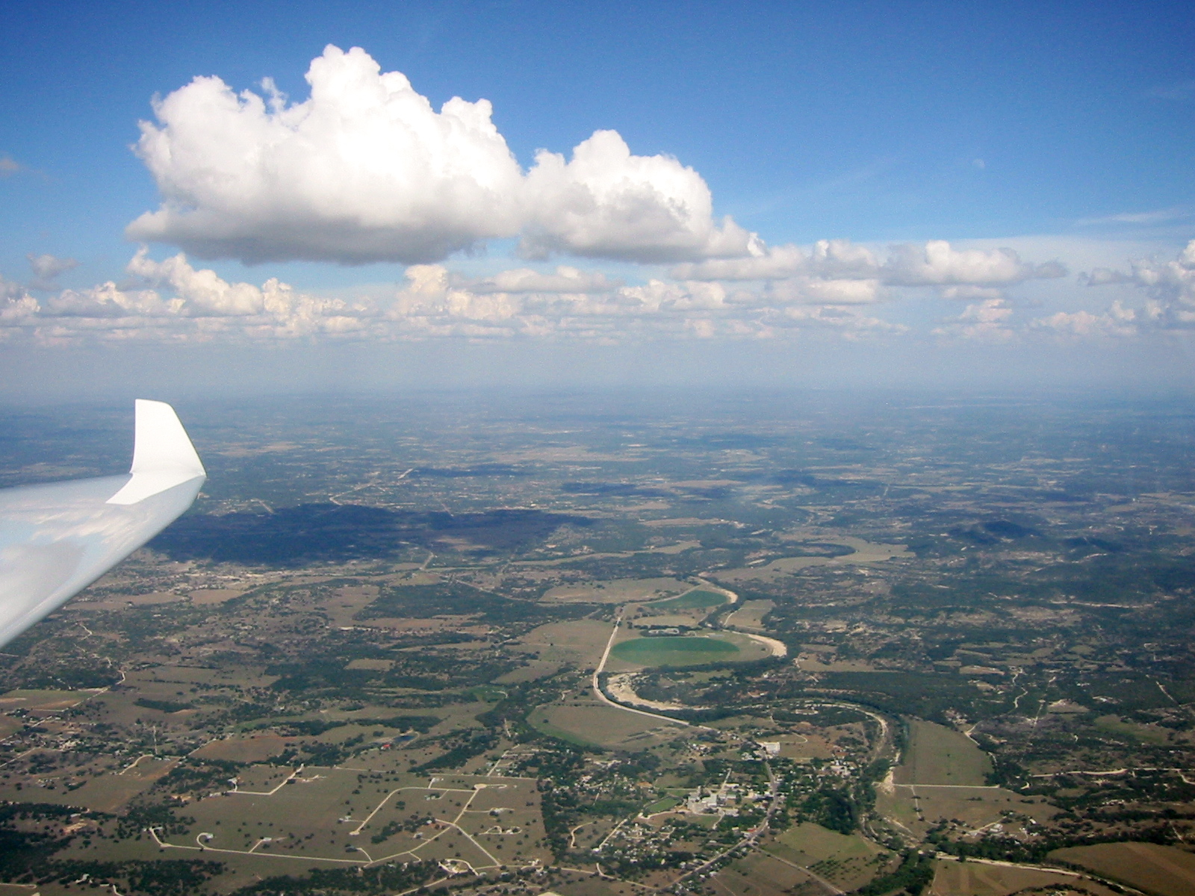
Decision Heights
At 3,000’ AGL
Start looking for general areas that appear landable. Head in that general direction.
.
By 2,000’
Select a specific field and look for obstacles and hazards. If possible, select an easy alternate in case, as you get lower, you find something wrong with your first choice.
By 1,000’
Commit to land in your chosen field.

Slide 7
Field Selection Preference
Airport!
Cultivated field (plowed and harrowed)
Young crop
Freshly harvested crop
Newly mowed fields of even texture
Pastures

Slide 8
Non-Towered Airports
Monitor CTAF when approaching to land
Request airport advisory
Landing pattern
Use segmented circle if present
Left-hand pattern if no other info
Enter at ~1,000’ unless otherwise indicated
Announce on CTAF (usually Unicom)
Watch out for. . .
Other traffic
Runway lights
Steep runway shoulders

Slide 9
Field Selection: Size and Color
Size
Best – Large field with no obstructions on the approach end
Color
Best – Evenly colored brown field
Next – Light green
AVOID – Bright yellow and light green
Straight lines or break in color may indicate a fence or ditch
Uneven colors – Uneven, rolling terrain

Slide 10
Field Selection Obstructions and Field Length
Minimum length
No obstacles on approach: 1,000’
Obstacles present: 1,500’
Obstruction at approach end reduces effective field length by 10x the obstruction height
5:1 Approach
Stopping Distance
Obstruction
500’
100’
1,500’
Field Length

Slide 11
Field Selection: Crop and Slope
Crop
Good – Freshly cultivated crop
Good – Freshly harvested crop
Poor – Rough, mottled texture, rocks
Slope
Always land uphill regardless of wind!
A slope that can be perceived from the air is steeper than you think
Landing uphill – carry a little extra airspeed on the approach

Slide 12
Field Selection: Wind
Land into wind whenever possible
But remember: Slope takes precedence!
Know Thy Wind!
Smoke, dust, water, cattle, flight computer

Slide 13
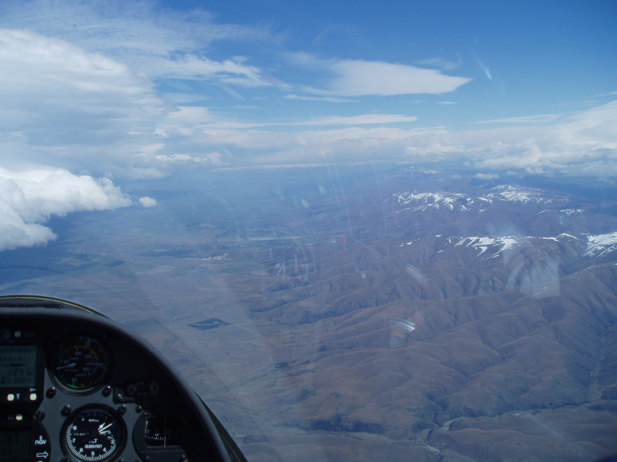
“Know Thy Winds!” -- a quote from Gavin Wills --
What is the wind at altitude? How do you know?
Flight computer
Drift of glider while thermaling
Movement of cloud shadows on the ground
What is the wind on the ground? How do you know?
Smoke from small fires
Wind signs on the water (ponds)
Trash moving in a field
Are the winds the same … probably not.
Thermals will cause a distinct shift in the wind direction on the ground so pay attention.

Slide 14
Field Selection: Livestock
If at all possible, avoid fields containing livestock
Cattle will walk over the glider, lick it, etc.
Bulls!! (Ask Francois Pin)

Slide 15
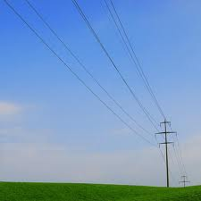
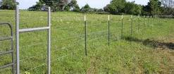
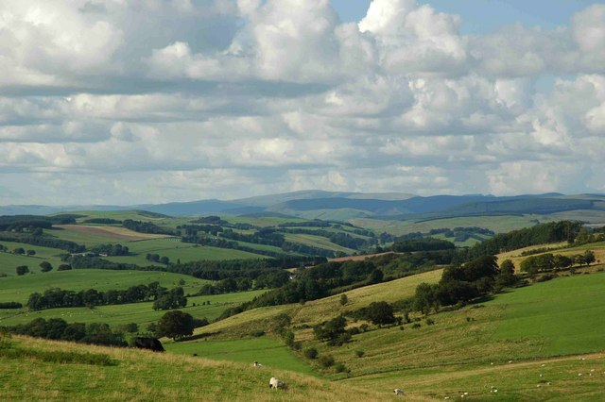
Serious Hazards
Wires
Fences
Slopes

Slide 16
Field Selection: Wires
Wires are often invisible
Pole shadows are sometimes visible
NEVER fly under wires
Roads and buildings are often accompanied by wires
Watch for wires leading to buildings inside fields

Slide 17
Field Selection: Bad…
Water
Swamps
Tall grass or crops
Most roads

Slide 18
Pop Quiz!
Which of the following describes the best off-field landing site?
No obstructions, 1,000’ long
No obstruction on approach, slightly downhill, 1,500’ long
No obstruction on approach, downwind, 1,200’ long
100’ obstruction on approach, 1,800’ long

Slide 19
Pattern and Approach
Use 360 degree pattern for all off-field landings
Otherwise, same procedure as at home field
Pre-Landing
Checklist
Continue to
Check Field
Wind
Check:
Obstructions
Field Condition
Wind

Slide 20
Common Errors
Not using angles to judge approach
Too close to field on downwind
Turning onto base leg too early
Too high on final
Excessive airspeed (esp. on final approach)
Poor coordination
Forgetting pre-landing checklist

Slide 21
Landing
Land in the ‘middle’ of the largest field
Pattern speed
Same as at home given wind and turbulence
Touch down at minimum speed
Two-point or slightly tail-first touchdown
Stop as soon as possible
In high crops
Keep wings level and no airbrakes
Never land with the gear retracted
Unless the POH recommends otherwise

Slide 22
After Landing
Inspect and secure glider
Get coordinates from flight computer
Call or home and report your position and status to your crew
Make sure lat and lon are in format crew needs
Use SPOT ‘Help’ function if appropriate
Find landowner if possible
Take pen, paper, road maps, valuables
Assess field access and plan for trailer routing and disassembly process
Wipe down glider
Remove tape and possibly winglets and stab
If most others are still flying, think about and write down errors you made and how you might have avoided a landout

Slide 23
Post-Flight Analysis

Slide 24
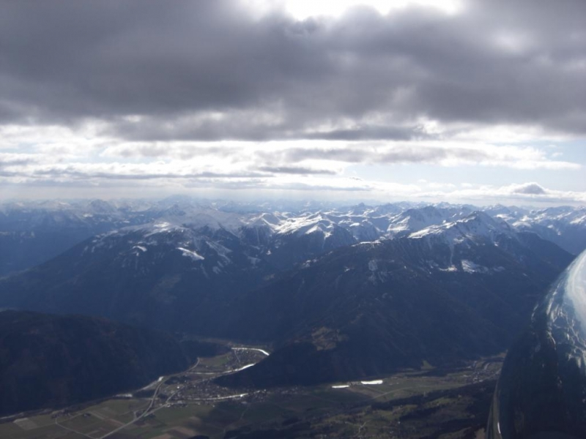
Six Week Agenda
Weather and Preparation (needed skills, glider & instrumentation, biological)
Thermals and Triggers
Climbing—and the art of thermaling
Cruising and In-Flight Decision Making
Outlanding and Post-Flight Analysis
Flight Computers and Final Glides

